Slide 1
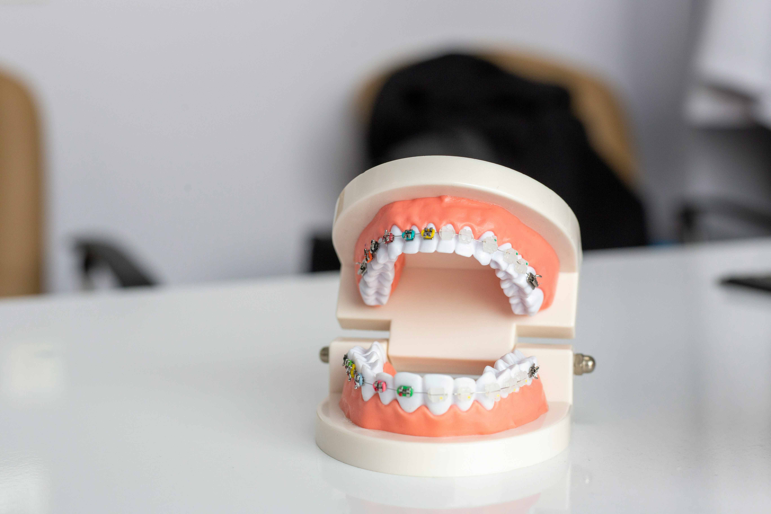
Automated Identification of Faulty Teeth in CBCT Images Using Deep Learning

Slide 2
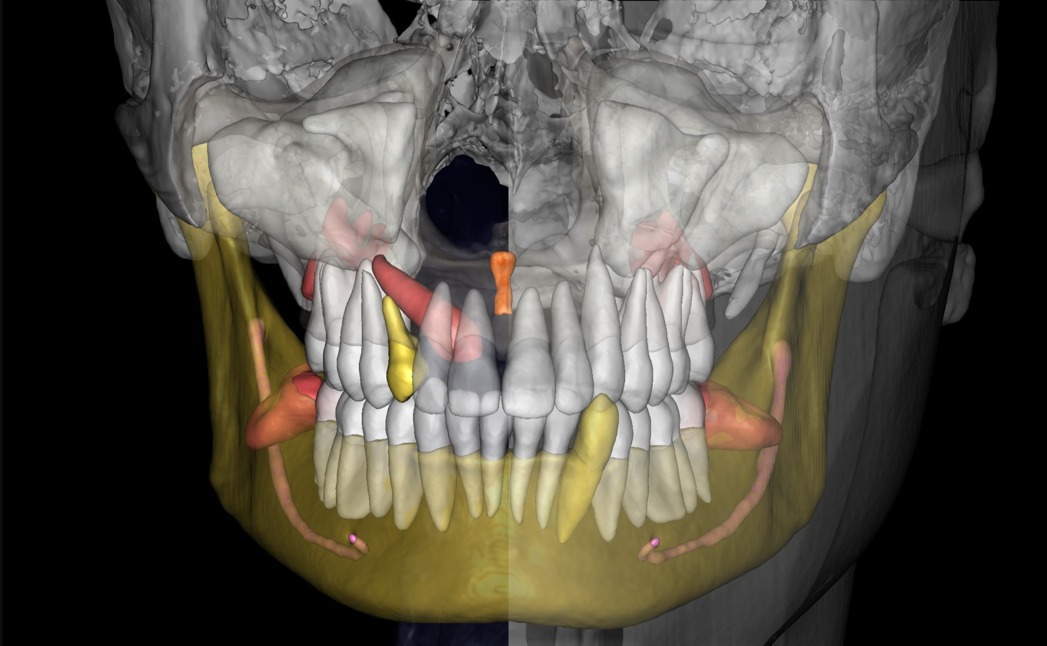
Section 1:
Introduction

Slide 3
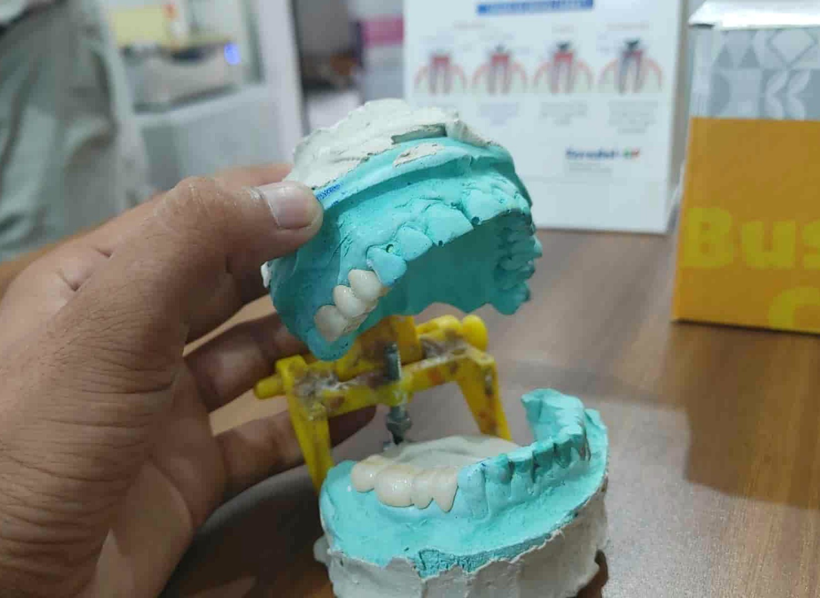
Introduction
This presentation will focus on the application of YOLOv8 for segmenting teeth in dental CBCT images.
We also throw some light on the importance of Accurate segmentation which is crucial for dental diagnosis, treatment planning, and monitoring.
In our project, we use the YOLOv8 model for the identification and classification of dental structures.
This technique enhances the interpretation of dental images, leading to improved patient outcomes.

Slide 4
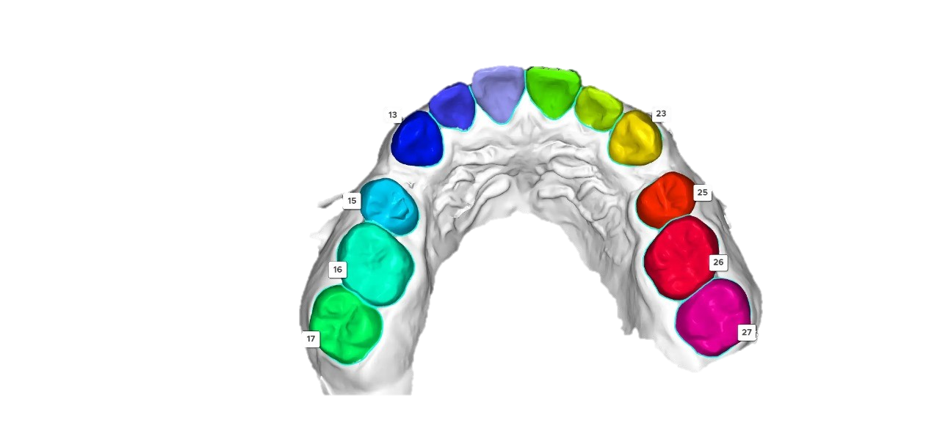
Objectives
To identify and classify teeth in dental CBCT images, ensuring each tooth is accurately segmented with unique identifiers and visually distinct colors for enhanced clarity and analysis.
Significance
This approach significantly aids dentists by providing a detailed and precise visualization of each tooth, enabling them to make more accurate diagnoses, identify potential issues early, and develop effective, personalized treatment plans tailored to the specific needs of each patient.

Slide 5
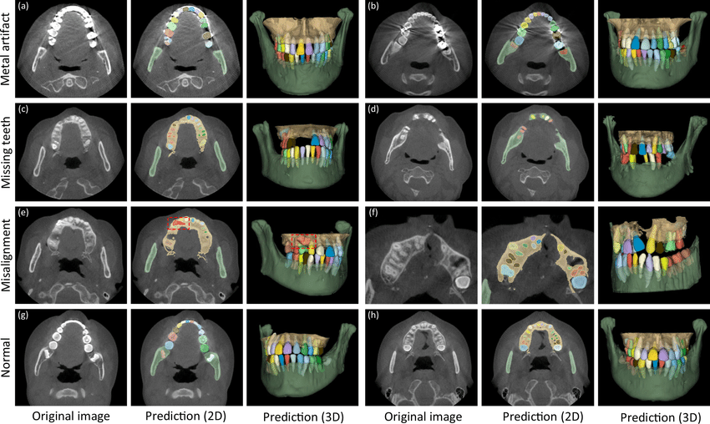
Section 2
Dataset Overview- Summary of dataset components and splitting of dataset.

Slide 6
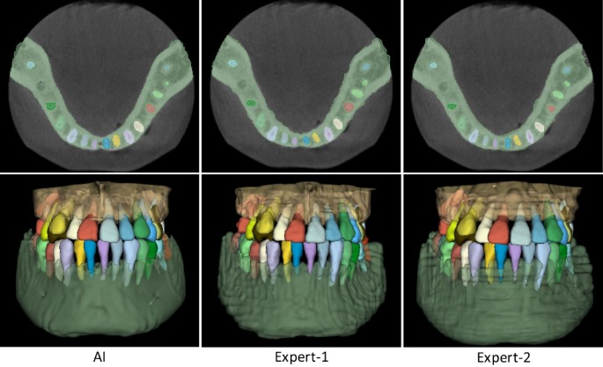
Total images -
The dataset contains a total of 1022 Dental CBCT images.
Annotation Format -
All annotations are provided in JSON files using polygon annotations.
Meta Information -
The dataset includes a meta.json file that contains class IDs, titles, and colors.

Slide 7
Splitting of dataset -

Slide 8
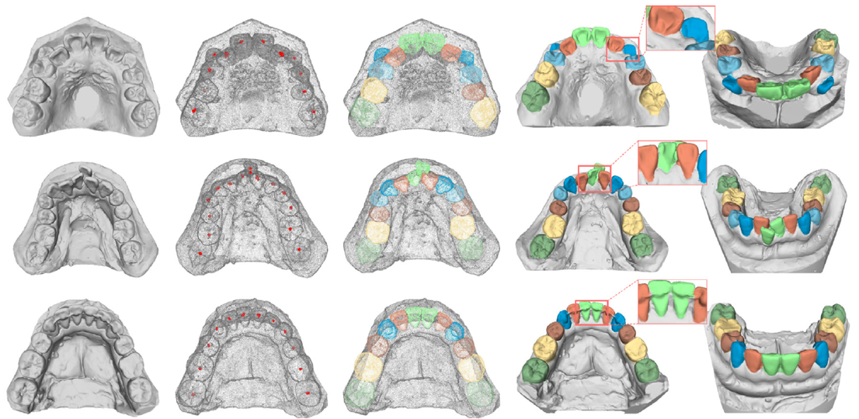
Section 3
Understanding annotation formats and meta fields.
Understanding features and benefits of YOLO v8
YAML configuration

Slide 9
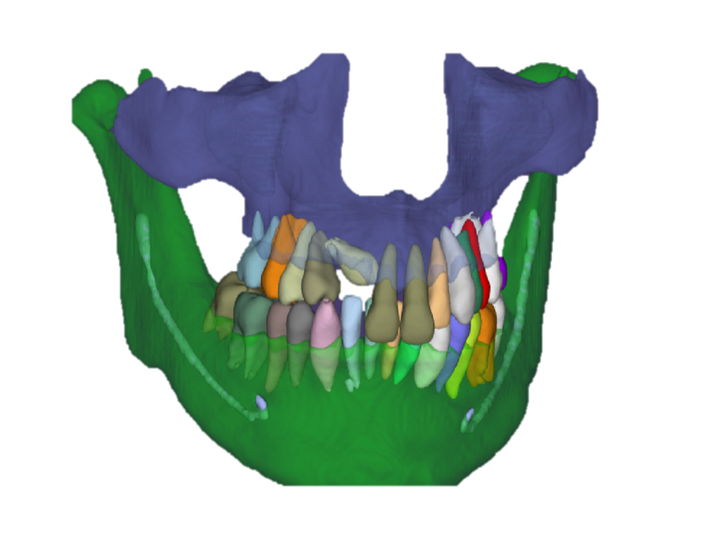
Annotation Format
JSON annotations are used with polygonal shapes to define tooth boundaries
Meta.json fields
The classes are identified with IDs ranging from 1 to 32.
Color coding
Each type of tooth is assigned a unique color for easy identification.

Slide 10

YOLOv8 Features-
State-of-the-art object detection framework: YOLOv8 is an advanced framework particularly effective for analyzing dental images.
Effective for dense, small object detection: Designed to excel in detecting small objects like teeth, making it ideal for dental applications.
Fast inference times: Provides rapid processing capabilities, suitable for real-time applications in various settings.
Support for polygon-based segmentation: Offers precise segmentation of tooth boundaries, enhancing the accuracy of dental image analysis.

Slide 11
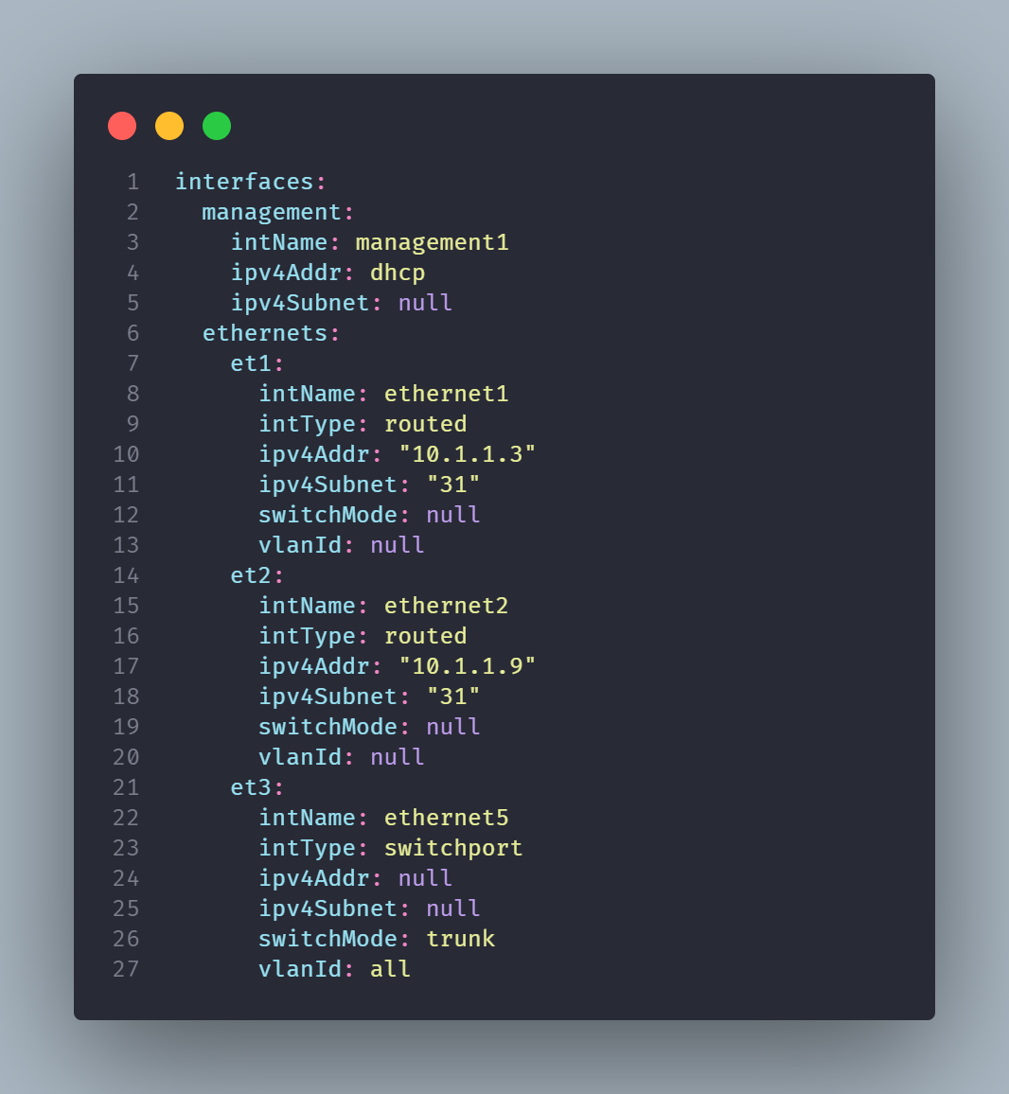
YAML configuration -
Path Details: Overview of the dataset directory structure for model training.
Class Definitions: Defines 32 tooth classes with 'nc: 32'. Class names are listed from '1' to '32' for easy reference.
The adjoining figure shows a YAML code snippet for clarity.

Slide 12
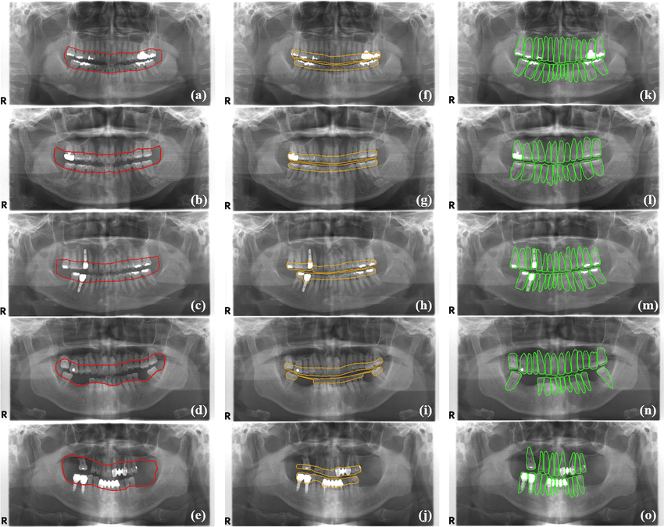
Section 4
Model Architecture- YOLO v8 components and it’s features.

Slide 13
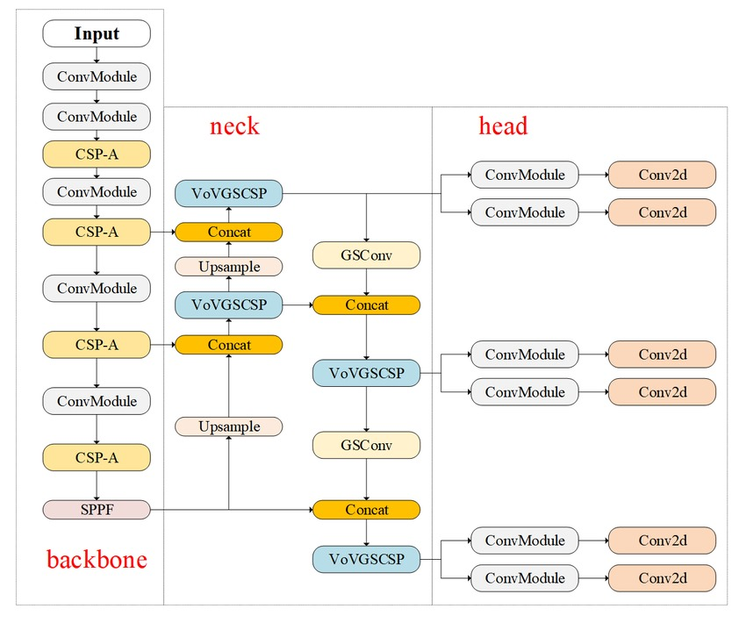
YOLOv8 High level architecture-

Slide 14
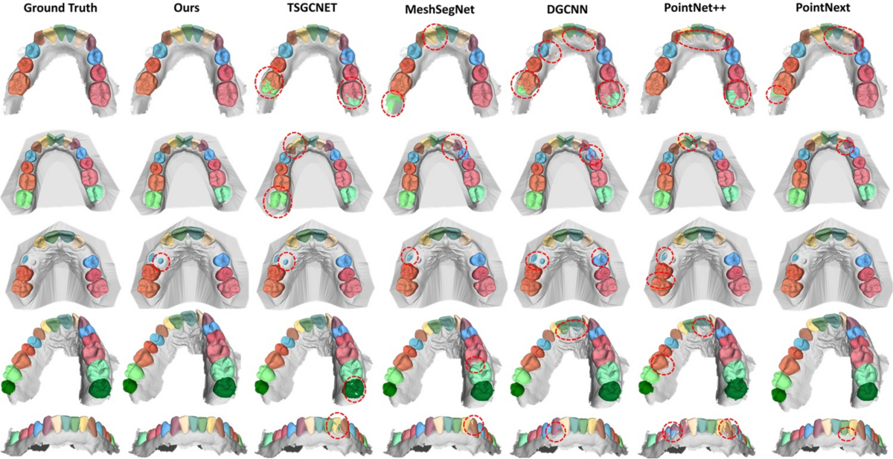
Section 5
CNN Model
Testing, Evaluation and Accuracy
Visual Results
Challenges Faced
Practical Applications & Future scope

Slide 15
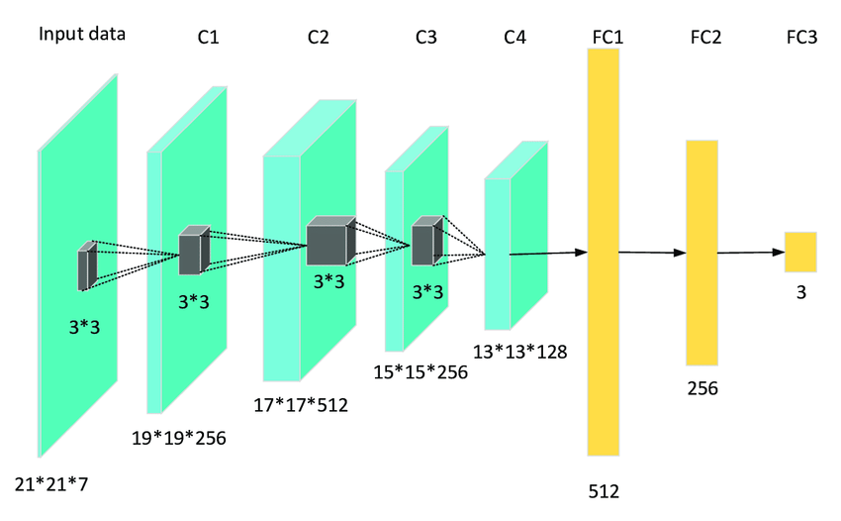
CNN Model-Sequential Keras Architecture
A Convolutional Neural Network (CNN) is a deep learning model widely used for image classification, object detection, and segmentation tasks. In the case of dental X-ray analysis, a CNN can effectively segment teeth into normal and abnormal types by learning important visual patterns.
Here we used 4 types of layers: InputLayer(PreprocessingStage), FeatureExtraction(ConvolutionalLayers), Flattening&FullyConnectedLayers(ClassificationStage), OutputLayer(PredictionStage)

Slide 16
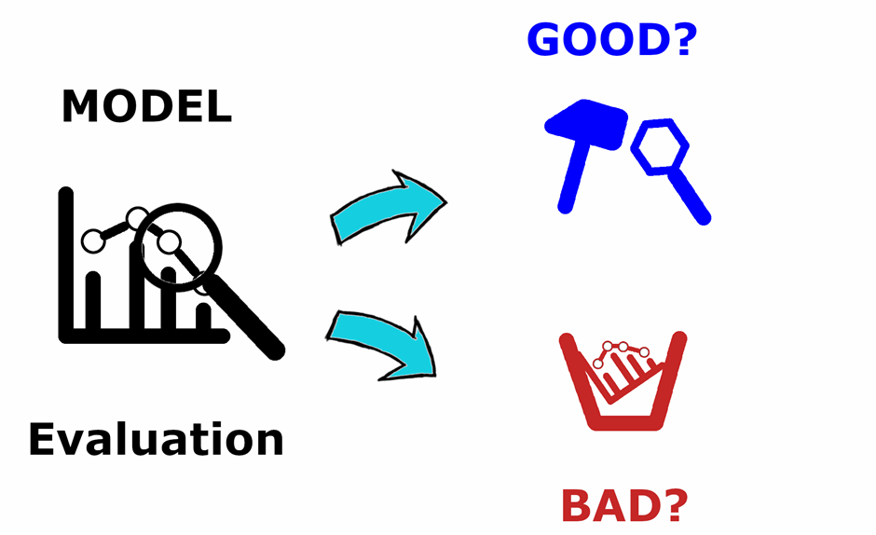
Testing, Evaluation, Accuracy-
Testing Setup : Input involves a single X-ray image to evaluate model performance, resulting in color-coded segmented teeth with corresponding numbers.
Evaluation Metrics : Metrics such as Precision, Recall, and mAP (mean Average Precision) are used to assess the accuracy of the model.

Slide 17

Testing, Evaluation, Accuracy-
The model has achieved a precision of 94.3%, a recall of 92.3%, and a mean average precision (mAP) of 72.9%, with an AP50 of 94.6% across all tooth classes. These results demonstrate a strong balance between precision and recall, highlighting the model’s effectiveness in accurately localizing and identifying teeth within the dataset. Notably, YOLOv8 exhibited high precision in detecting molar teeth, achieving a mAP of nearly 80.0% despite their complex shapes, further reinforcing its robustness in dental image analysis.

Slide 18
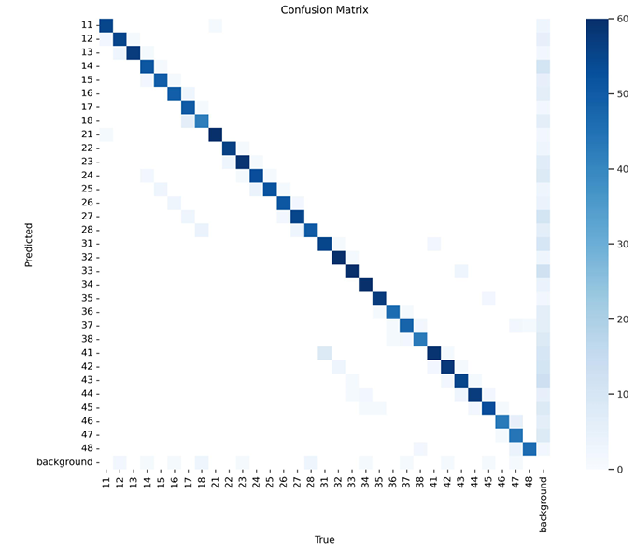
Testing, Evaluation, Accuracy-
The confusion matrix in Fig. illustrates YOLOv8’s predictions at a confidence threshold of 0.5 and an IoU threshold of 0.5. The final row, which represents unclassified tooth instances, suggests that while YOLOv8 accurately identified most teeth with minimal misclassifications, it failed to detect certain instances above the confidence threshold. This implies a lack of sufficient knowledge about some tooth instances in specific images from the dataset.

Slide 19
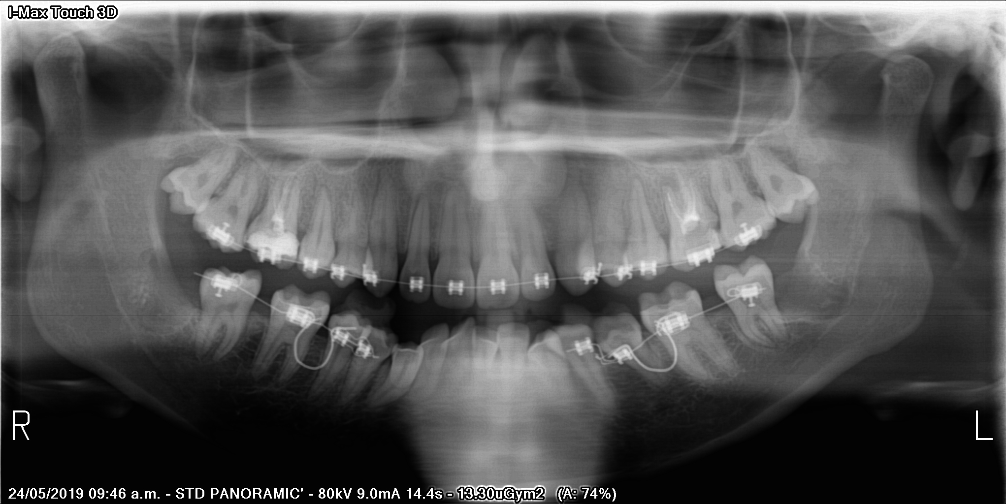
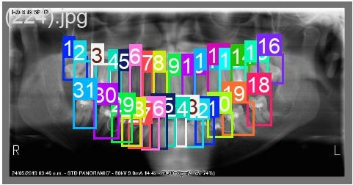
Visual Results-
Input :
Output:

Slide 20

Challenges faced-
Dataset challenges : Issues with irregular tooth boundaries affect segmentation accuracy and overlapping teeth in X-rays complicate detection.
Technical Challenges : Fine-tuning the model for optimal performance on small objects and managing high computational requirements leading to extended training times.

Slide 21
Practical Applications-
Automated Dental Analysis : Utilization of technology to assist dental practitioners in conducting accurate analyses.
Technical Challenges : Fine-tuning the model for optimal performance on small objects and managing high computational requirements leading to extended training times.
Surgical Planning Tools : Use of technology to enhance the precision of surgical planning in dentistry.
Educational Tools for Dental Students : Development of innovative educational resources to enhance learning experiences for dental students

Slide 22
Conclusion-
This project demonstrates the effectiveness of YOLOv8 for CBCT-based dental image segmentation, achieving high accuracy in identifying individual teeth despite complex anatomy and overlaps. Automating this process reduces manual effort and improves consistency in diagnostics. Additionally, a Sequential CNN is used to classify teeth as normal or abnormal, enhancing diagnostic precision. Trained on 1022 annotated CBCT slices, the system ensures robust performance across diverse cases. This two-stage approach—segmentation and classification—enables efficient, accurate dental analysis and supports improved treatment planning.

Slide 23

Manoj Kumar Pradhan – 2105557 Omprakash – 2105560 Sayan Adhikari – 2105577 Raj Singh – 2105732 Sarthak Bhowmik - 21052616

